Slide 1
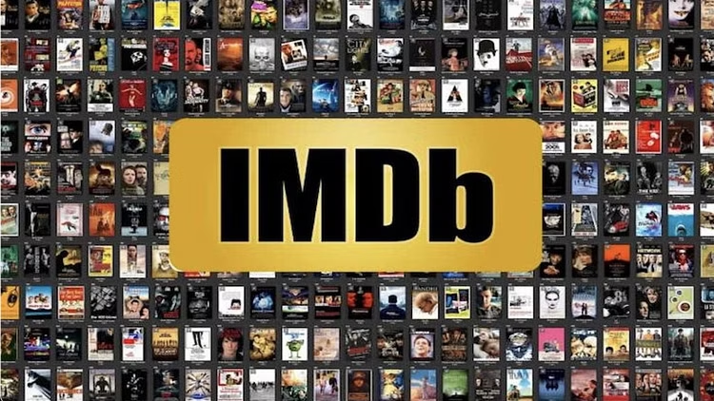
IMDB Movie
Analysis
Divyasri Jegan

Slide 2
Project Description :
A potential question for filmmakers to investigate could be: “What factors influence the success of a movie on IMDB?” Here, success can be defined by high IMDB ratings. The impact of this question is significant for movie producers, directors, and investors who want to understand what makes a movie successful to make informed decisions in their future projects.
This Project is about giving insights about success of a Movie based on IMDB data provided which will be helpful for filmmakers and other stakeholders during production of a movie.

Slide 3
Approach :
Tech Stack Used
Dataset Overview
Data Pre-Processing
Insights
Conclusion
Links

Slide 4


Tech Stack Used :
Extract, manipulate and process the data to make decisions.
Make interactive charts for better visualization.
Prepare a presentation to tell the data story.

Slide 5
Dataset Overview :
Source of Data: https://drive.google.com/file/d/1XpGThHzLnXxL_7aQo2sCpYL3SeB18MMB/view?usp=sharing
The dataset provided is related to IMDB Movies and contains records of movies from a number of years and geographical locations.
The Dataset details are: - Number of Data-Points: 5,043 - Number of Features: 28 - Column Details:
Color, director_name, num_critic_for_reviews, duration, director_facebook_likes,
Actor_3_facebook_likes, actor_2_name, actor_1_facebook_likes, gross, genres,
Actor_1_name, movie_title, num_voted_users, cast_total_facebook_likes, actor_3_name,
Facenumber_in_poster, plot_keywords, movie_imdb_link, num_user_for_reviews,
Language, Country, content_rating, budge,t title_year, actor_2_facebook_likes,
imdb_score, Aspect_ratio, movie_facebook_likes …

Slide 6
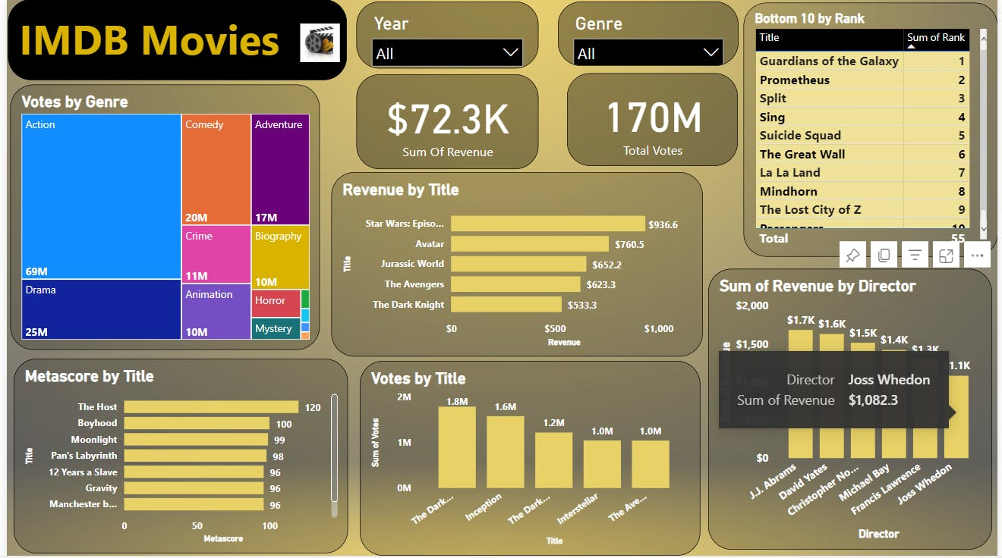
Insights :
Data Analytics Tasks:
Movie Genre Analysis
Movie Duration Analysis
Language Analysis
Director Analysis
Budget Analysis

Slide 7
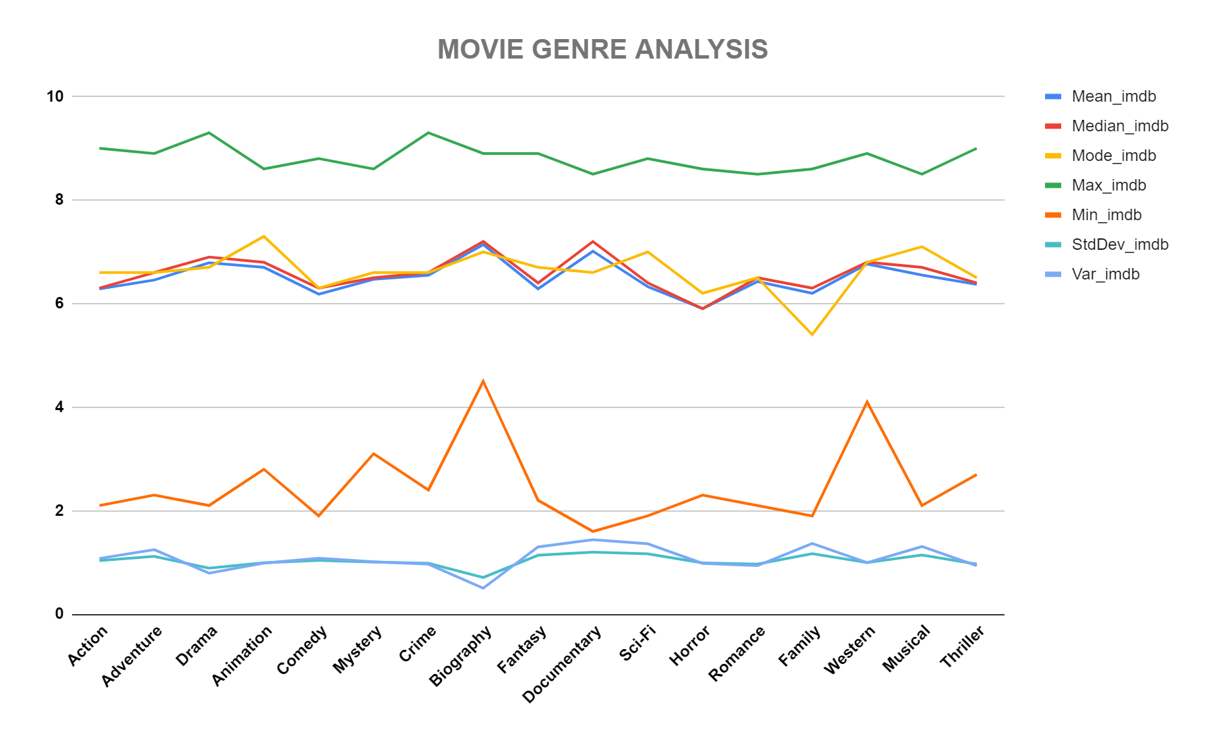
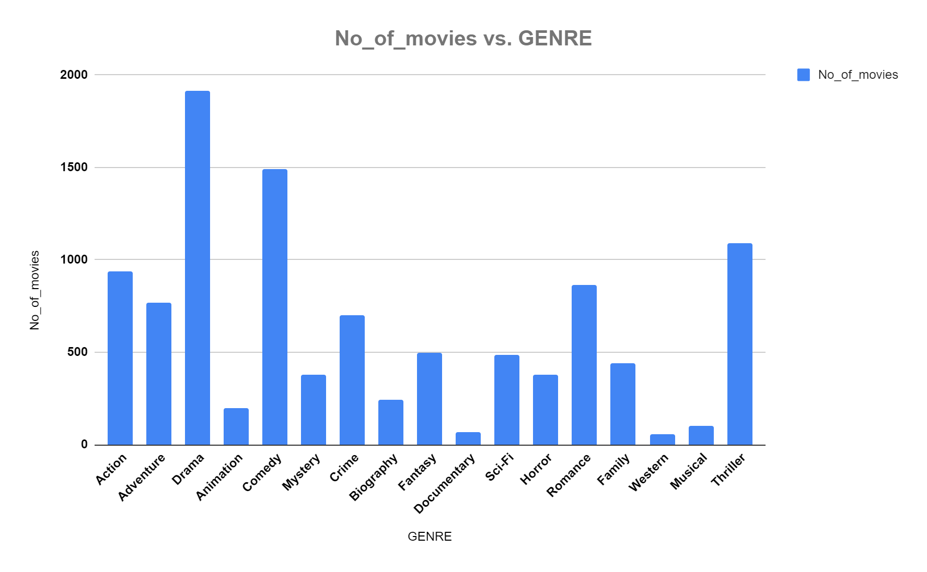
01
Movie Genre Analysis
Analyze the distribution of movie genres and their impact on the IMDB score.
Task: Determine the most common genres of movies in the dataset. Then, for each genre, calculate descriptive statistics (mean, median, mode, range, variance, standard deviation) of the IMDB scores.
Result: The top 7 most common genres are Drama, Comedy, Thriller, Action, Romance, Adventure and Crime. Also all the top 7 genres’ descriptive statistics are almost at same level.

Slide 8
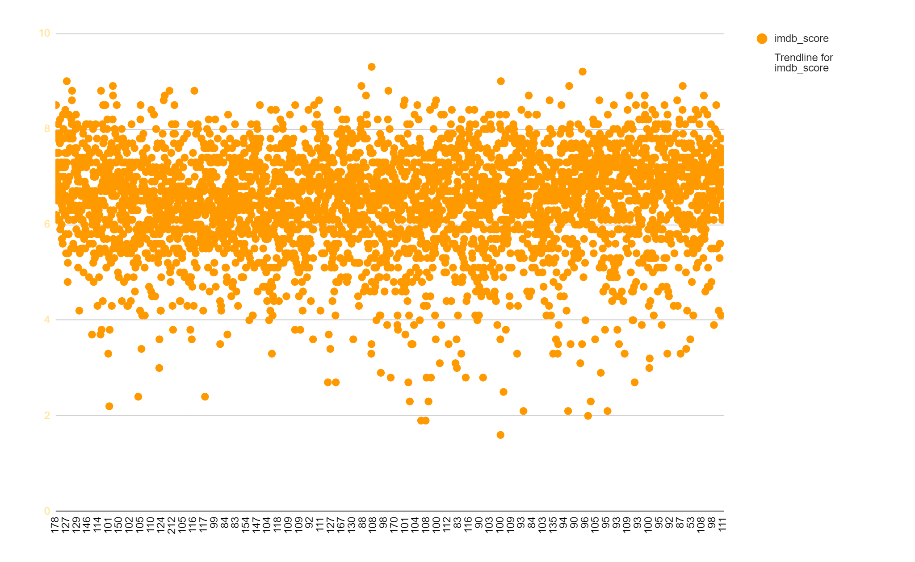
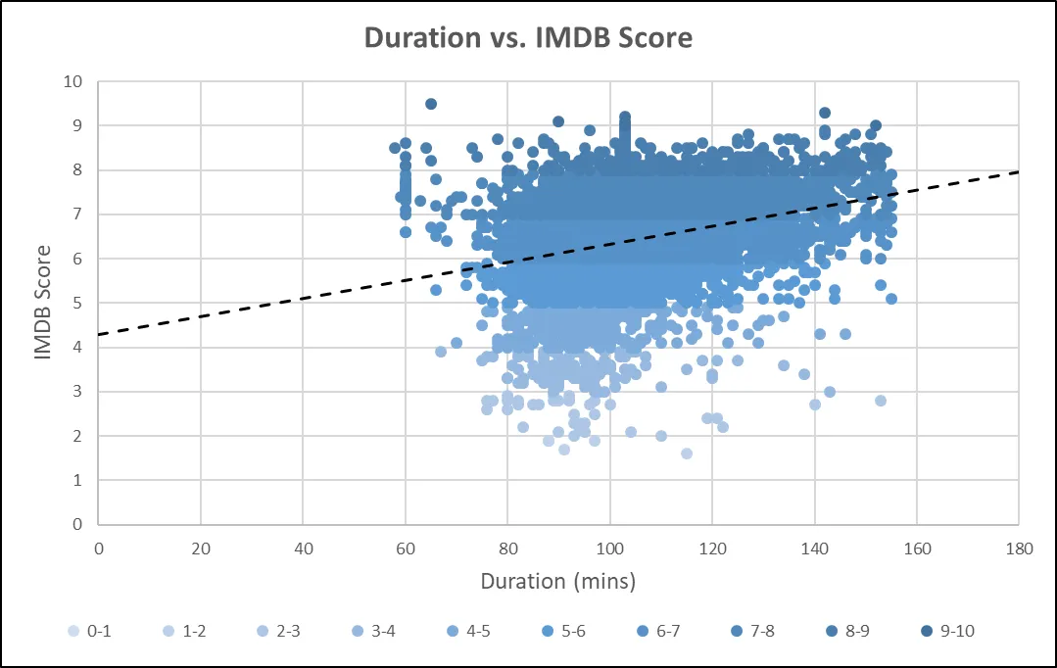
02
Movie Duration Analysis
Movie Duration Analysis: Analyze the distribution of movie durations and its impact on the IMDB score.
Task: Analyze the distribution of movie durations and identify the relationship between movie duration and IMDB score.
Result: The distribution of Movie Durations shows that it closely follows a Normal Distribution. Also the scatter plot shows that duration and imdb_scores have a positive relationship.

Slide 9
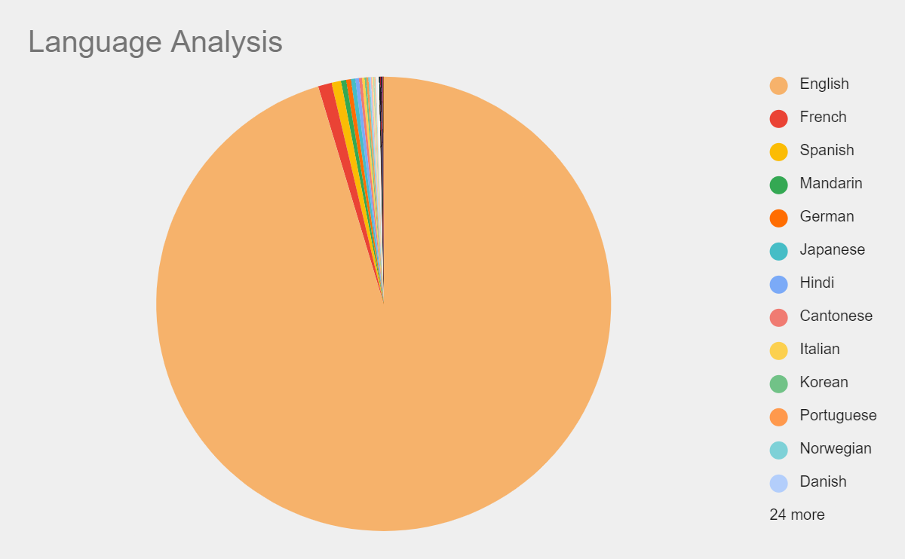
03
Language Analysis
Situation: Examine the distribution of movies based on their language.
Task: Determine the most common languages used in movies and analyze their impact on the IMDB score using descriptive statistics.
Result: The left plot show that English is the most common language used in movies followed by French, Spanish, Hindi and Mandarin. The right plot shows that French language has comparatively higher mean and median but lower variance and standard deviation implying that most of the French language movies have their imdb score on the higher side.

Slide 10
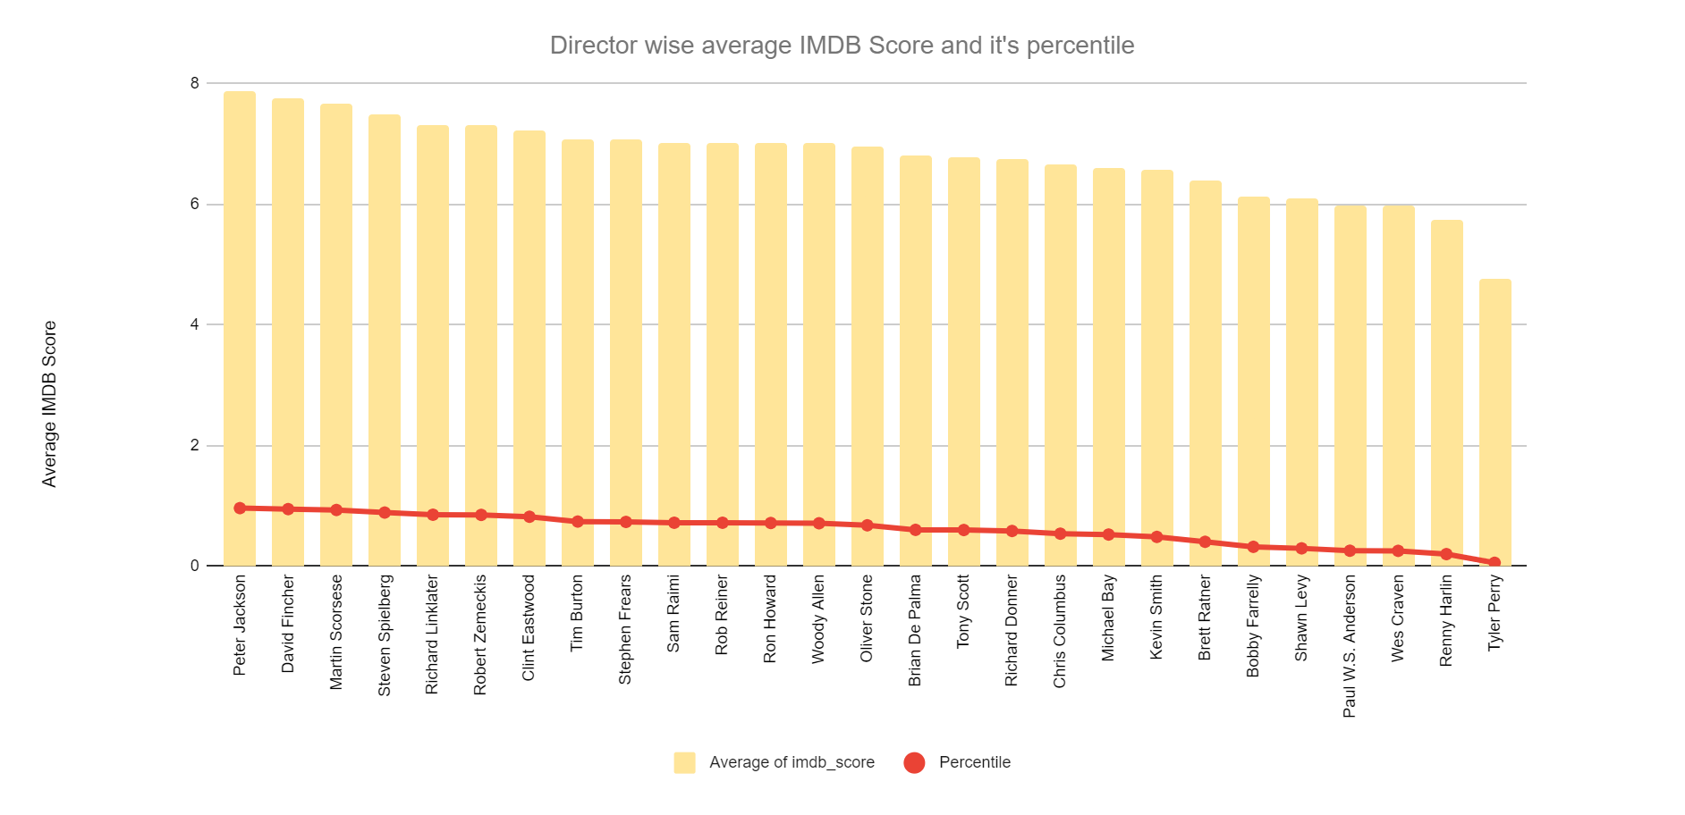
04
Director Analysis
Influence of directors on movie ratings.
Task: Identify the top directors based on their average IMDB score and analyze their contribution to the success of movies using percentile calculations.
Result: The plot considers only those directors whose movie counts are more than 9 and the range of IMDB Scores is less than equal to 3 as otherwise it would be unfair for those who has maintained consistently high scores for large number of movies to be compared for top directors to those who has performed well in few movies.

Slide 11
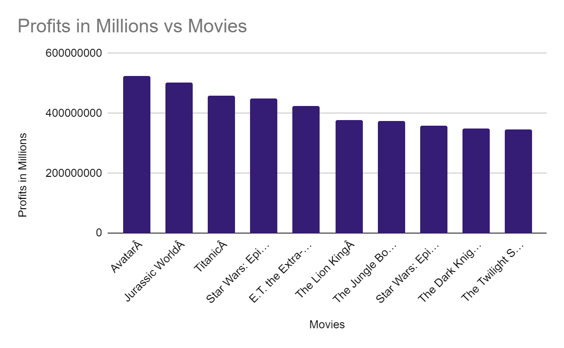
05
Budget Analysis
Explore the relationship between movie budgets and their financial success.
Task: Analyze the correlation between movie budgets and gross earnings, and identify the movies with the highest profit margin.
Result: The table shows that the correlation between Gross and Budget is positive and more than 0.5. That is, the relationship shows that as budget of movies increase, there is a very high probability that the gross collection of the movie will also increase. The plot shows the relationship between Gross and Budget. The overall trendline has a slope close to 1.

Slide 12
Links:
Source dataset : https://drive.google.com/file/d/1XpGThHzLnXxL_7aQo2sCpYL3SeB18MMB/view?usp=sharing
Google sheet : https://docs.google.com/spreadsheets/d/1X1tjxrw9C2sRbrcvVmY9-h1aIm-zvkI4iXwdHdFL8G4/edit?usp=sharing

Slide 13
Conclusion:
Through this project, I was able to understand the importance of Data Analytics in Movies analysis as it provides valuable insights such as director’s relationship with IMDB Score, genre’s relationship with IMDB Score, budget’s relationship with IMDB Score etc. which helps in making Data-Driven Decisions.
This helps in better usage and handling of data in excel and it provide a strong foundation on it too..

